Slide 1

MGMT-6056
PROJECT COST MANAGEMENT
PROJECT BUILD TREEHOUSE- BUNKIE
PREPARED BY:
GROUP 8
Jharana Ghimire 1187000
Kayani, Muhammad Haider 1170868
Gihan Shamike Liyanage 1142109

Slide 2
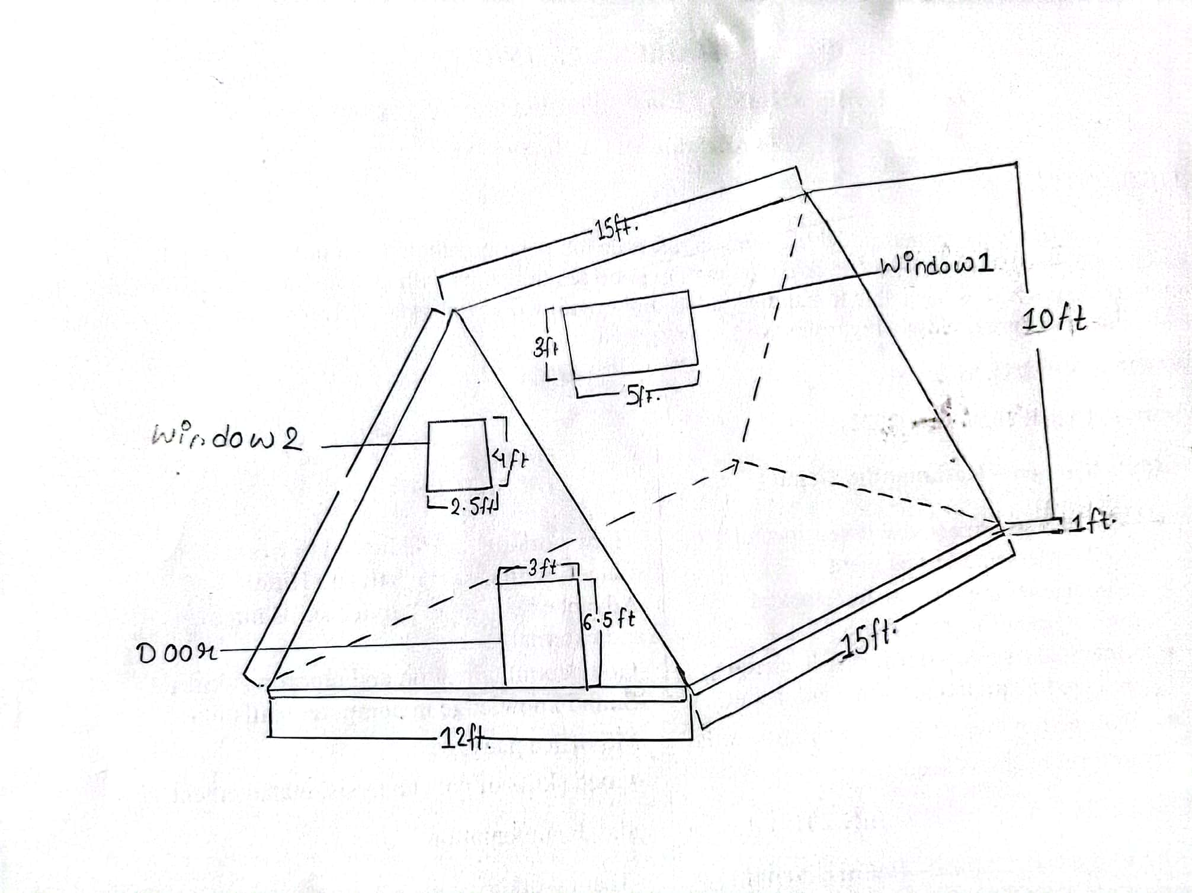
HAND DRAWN SKETCH- BEST VIEW

Slide 3
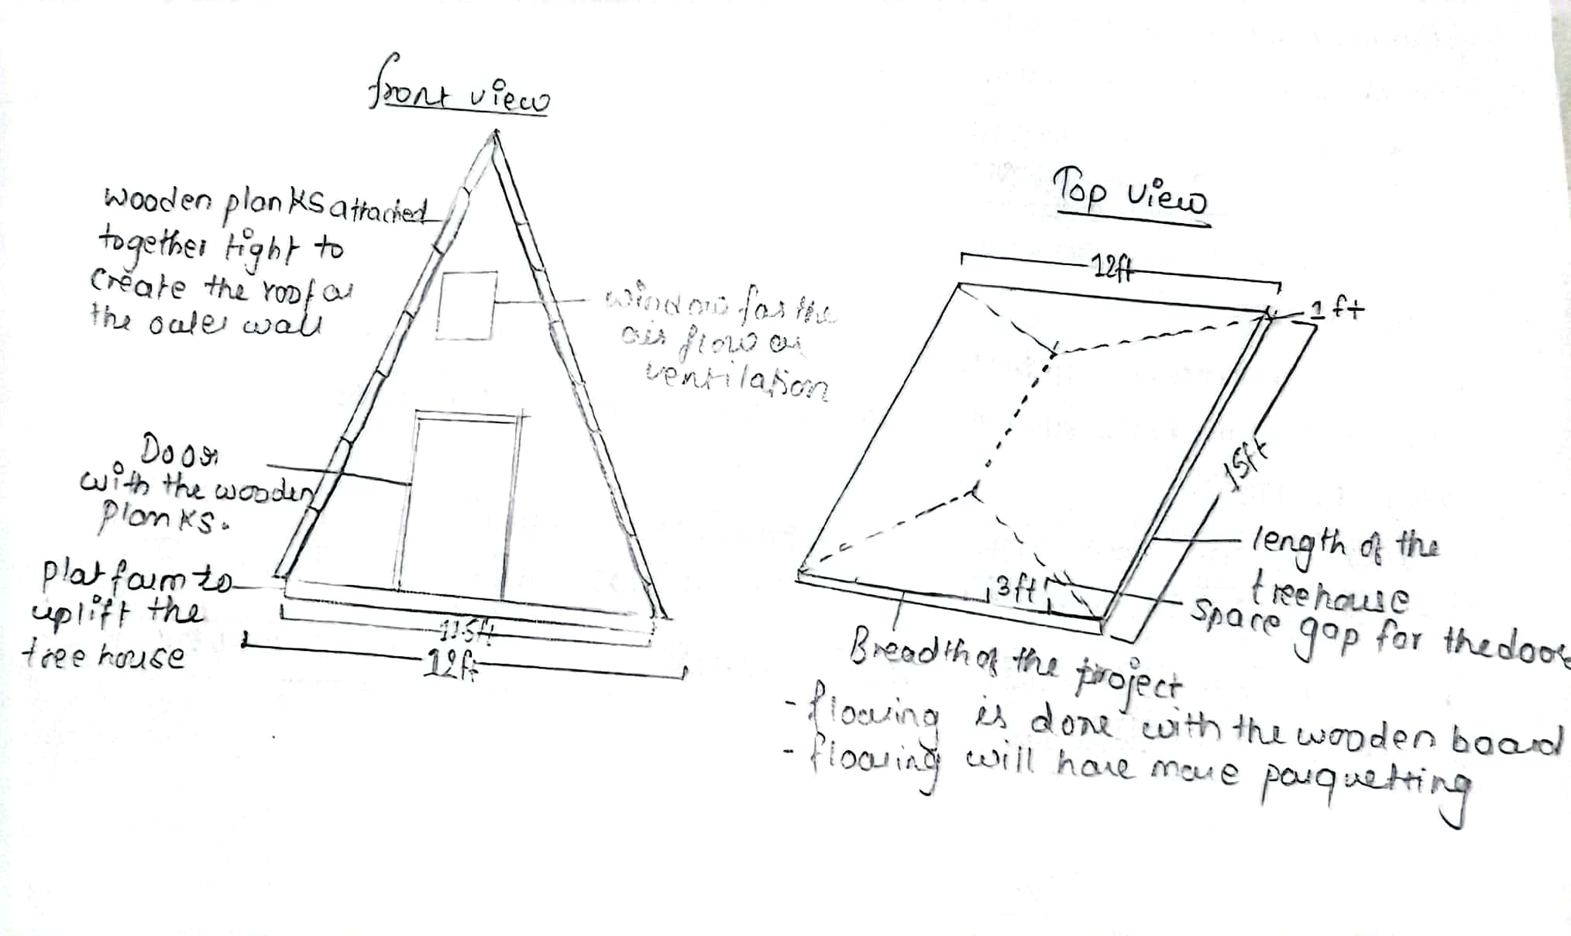
HAND DRAWN SKETCH- MORE DETAIL VIEW

Slide 4
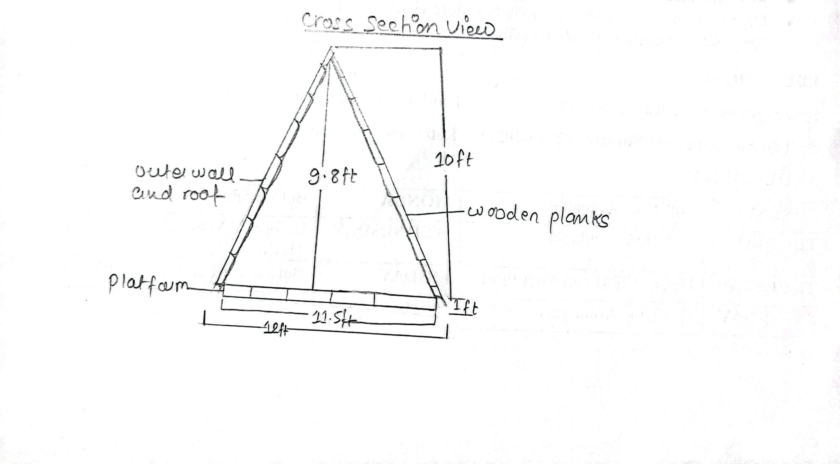
HAND DRAWN SKETCH- CROSS SECTION VIEW

Slide 5
ASSIGNMENT WORK PLAN
DISCUSSION FOR THE ASSIGNMENT
ALL
12TH NOV
PREPARATION OF SKETCHES
JHARANA
15TH NOV
CONSTRUCT WBS SHAMIKE
18TH NOV
GENERATE GANTT CHART SHAMIKE
19TH NOV
ALLOCATE BUDGET SHAMIKE
20TH NOV
ALLOCATE RESOURCE USAGE SHAMIKE
22ND NOV
COMPILE THE PROJECT
ALL
1ST DEC
DRAW SKETCHEN INTO PPT FILE JHARANA
28TH NOV
PREPARE POWERPOINT OUTLINE JHARANA
28TH NOV
GENERATE CALCULATION ON EXCEL HAIDER
26TH NOV
GENERATE DATA ON EXCEL
HAIDER
25TH NOV
PREPARE THE EXCEL OUTLINE HAIDER
25TH NOV
REVIEW THE PROJECT- ALL
2ND DEC

Slide 6
WBS | CONTROL ACCOUNT NAME | BASELINE COST
1.1 | Preparation | 6,610.00
1.2.1 | Buying Resources | 7,798.00
1.2.2 | Custom Steel Bracket Construction | 526.00
1.2.3 | Tree House Construction | 478.00
1.2.4 | Suspension Bridge Construction | 2088.00
1.3.1 | Quality control | 3280.00
1.3.2 | Issue Resolution | 600.00
1.4.1 | Customer Acceptance and Project Closure | 1200
 | TOTAL | 22580.00

Slide 7


